Slide 1
Advanced Parallel Programming over Distributed Data

Slide 2
Dryad
General-purpose execution environment for distributed, data-parallel applications
Automatic management of scheduling, distribution, fault tolerance, etc.

Slide 3
Dryad Expressive Power
Many programs can be represented as a distributed execution DAG
Iteration is not supported

Slide 4
Job = Directed Acyclic Graph
Outputs
Processing
vertices
Channels
(file, pipe,
shared
memory)
Inputs
Notes:
A dryad application is composed of a collection of processing vertices (processes).
The vertices communicate with each other through channels.
The vertices and channels should always compose into a directed acyclic graph.

Slide 5
Advanced Algorithms
PageRank
K-Means
Decision Tree
…
Iteration / Recursion is a must!

Slide 6
Challenge
How to introduce a cyclic edge?
Bind computation with data (process node)
Take advanced of memory channels

Slide 7
Dryad+
From DAG to directed graphs with cycles
Function in SCOPE
Function can be recursive
Constraints:
Tail recursion only
One recursive call only
No embedded recursive function

Slide 8
Recursion
Why tail recursion?
Avoid having to “remember” previous status
Why not just Loop?
Many algorithms are more naturally expressed in recursion
E.g. decision tree
What if multiple recursive calls needed?
E.g. decision tree
“Merge” into one recursive call

Slide 9
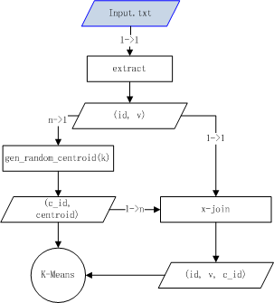
K-Means
ds
Code before calling the recursive function K-means()

Slide 10
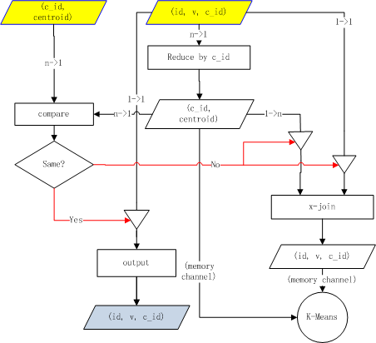
K-Means
Stop condition: A special input consisting of a Boolean value controls the data flow.
Recursion: Data passes through memory channels, so that computation continues on nodes where data is.

Slide 11
Multiple recursive calls
E.g., at the end of function f(X), we have two recursive calls: f(X1) and f(X2)
If we execute f(X1) first, we need to hold on to X2, and shuffle X1 to all nodes to utilize parallelism
Turn depth-first to breadth first to maximize parallelism

Slide 12
Multiple recursive calls
Instead of calling f(X1) and f(X2) separately
Tag the data: X = {<tag,x>}, where tag = 0 or 1 <0,x> for x in X1 <1,x> for x in X2
Make one recursive call f(X)

Slide 13
Recursive call on tagged data
All execution will be performed with GROUP BY tag
Result reduced by tag
If data is too fragmented by tagging, shuffle the data before execution

Slide 14
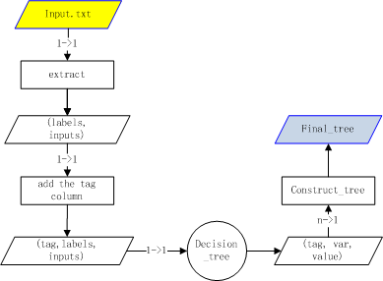
Example: Decision Tree Construction

Slide 15
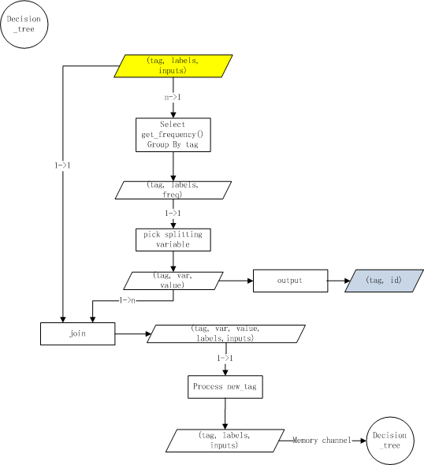
Example: Decision Tree Construction (recursive part)

Slide 16
K-Means (Script)
/* assume the input row is an id followed by a list of n feature values: id: v1 v2 v3 ... v_n */
Raw_Inputs =
EXTRACT id, values
FROM input.txt
USING myextractor.exe;
/* k-row of (cluster_id, values) pairs */
Init_Means =
REDUCE Raw_Inputs ALL
PRODUCE (cluster_id, values)
USING gen_random_centeroids;
Means_Solution_Pairs =
SELECT Init_Means.cluster_id as mean_id, Init_Means.values, Inputs.values
FROM Init_Means CROSS JOIN Raw_Inputs;
/* solution is (cluster_id, id, values) */
Init_Solution =
REDUCE Means_Solution_Pairs
ON mean_id
PRODUCE cluster_id, id, values
USING get_solution_by_nearest_means;
k_means (Init_Solution, Init_Means);

Slide 17
K-Means (Script)
/Solution: <cluster_id, id, values> row set Means: <cluster_id, values> row set of size k*/
FUNCTION k_means (Solution, Means) = BEGIN
New_Means =
REDUCE Solution
ON cluster_id
PRODUCE cluster_id, values
USING get_mean;
Means_Pairs =
SELECT Means.values, New_Means.values
FROM Means, New_Means
WHERE Means.cluster_id == New_Means.cluster_id;
/* Return if the Means converge. equal_means is an aggregate function */
RETURN Solution
WHERE equal_means (Means_Pairs) = true;
Means_Solution_Pairs =
SELECT New_Means.cluster_id as mean_id, New_Means.values, Solution.values
FROM New_Means CROSS JOIN Solution;
New_Solution =
REDUCE Means_Solution_Pairs
ON mean_id
PRODUCE cluster_id, id, values
USING get_solution_by_nearest_means;
RETURN k_means (New_Solution, New_Means);
END

Slide 18
Decision Tree (Script)
/* This is a version with tail recursion */
/* The function below takes a rowset of labels and their corresponding
inputs, and returns rows of tags plus id
The ProblemSet contains a special column of tags */
/* ProblemSet : <tag, labels, inputs> */
FUNCTION decision_tree (ProblemSet) =
BEGIN
/* FreqVectors : <labels, vector> row set, where vector is the
histogram of all variables
get_frequencies is an aggregate function
that returns m rows where m
is the total num of labels */
FreqVectors =
SELECT ProblemSet.tag, ProblemSet.labels, get_frequencies(labels, inputs) as freq
FROM ProblemSet
GROUP BY ProblemSet.tag, ProblemSet.labels;
/* pick a best variable id to split from FreqVector */
Splitting_vars =
REDUCE FreqVectors
ON tag
PRODUCE tag, var, value
USING pick_split_var;
YIELD RETURN Splitting_vars;
ProblemPlus =
SELECT *
FROM ProblemSet, Splitting_vars
WHERE ProblemSet.tag == Splitting_vars.tag;
ProblemSet_NewTag =
PROCESS ProblemPlus
PRODUCE tags, labels, inputs
USING add_new_tag
RETURN decision_tree (New_solution);
END

Slide 19
Decision Tree (Script)
/*** Assume the input row is of following form:
<label> <id1:val1> <id2:val2> ... <id_n:val_n>
Assume that label takes m distinct values ***/
RawProblemSet=
SELECT labels, inputs /* inputs is a stream of input vars */
FROM input.txt
USING MyExtractor;
ProblemSet =
PROCESS RawProblemSet
PRODUCE tag, id, labels, inputs
USING add_tag_id;
Results = decision_tree(ProblemSet);
final_tree =
SELECT construct_tree(*)
FROM Results;

Slide 20
To Do
Valid the algorithms (on dryad+ systems)
Write more algorithms (currently 6 machine learning algorithms analyzed)

